Slide 1
Dynamic Programming

Slide 2
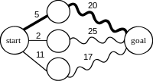
Greedy Approach
Greedy algorithms aim to make the optimal choice at that given moment.
Each step it chooses the optimal choice, without knowing the future.
It attempts to find the globally optimal way to solve the entire problem using this method.
Most of the popular algorithms using Greedy have shown that Greedy gives the global optimal solution every time. Some of these include:
Dijkstra's Algorithm
Kruskal's algorithm
Prim's algorithm
Huffman trees

Slide 3
Divide and Conquer
long factorial(int num)
{
//base condition
if(num == 0)
{
return 1;
}
else
{
// recursive call
return num * factorial(num - 1);
}
}

Slide 4
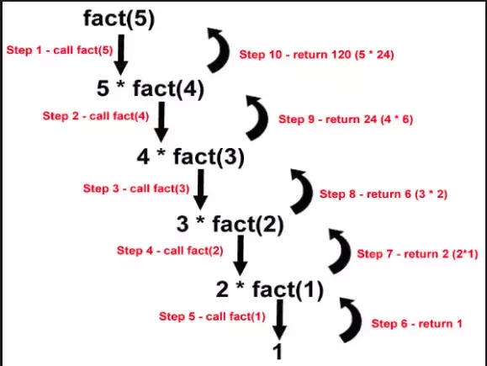
Divide and Conquer

Slide 5
Divide and Conquer
Divide
If the problem is small, then solve it directly. Otherwise, divide the problem into smaller subsets of the same problem.
Conquer
Conquer the smaller problems by solving them recursively. If the subproblems are small enough, recursion is not needed and you can solve them directly.

Slide 6
Fibonacci Numbers
Divide and Conquer
Fib(5) +
Fib(4) +
Fib(3) +
Fib(3) +
Fib(2) +
Fib(2) +
Fib(1)
Fib(2) +
Fib(1)
Fib(1)
Fib(0)
Fib(1)
Fib(0)
Fib(1)
Fib(0)

Slide 7
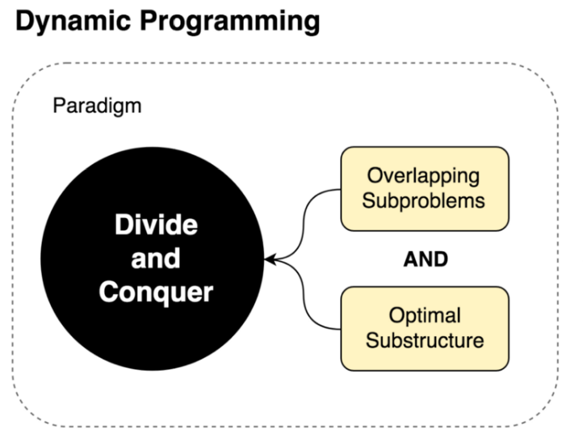
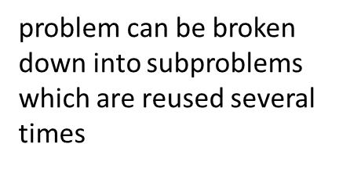
optimal solution can be constructed from optimal solutions of its subproblems
Dynamic Programming is an algorithm design technique for optimization problems: often minimizing or maximizing.
Like divide and conquer, DP solves problems by combining solutions to sub-problems.
Unlike divide and conquer, sub-problems are not independent.
Sub-problems may share sub-sub-problems,

Slide 8
Dynamic Programming
Principle of optimality
The principle of optimality states that an optimal sequence of decisions has the property that whatever the initial state and decision are, the remaining decisions must constitute an Optimal decision sequence with regard to the state resulting from the first decision

Slide 9
Dynamic Programming
Fib(5) +
Fib(4) +
Fib(3) +
Fib(3) +
Fib(2) +
Fib(2) +
Fib(1)
Fib(2) +
Fib(1)
Fib(1)
Fib(0)
Fib(1)
Fib(0)
Fib(1)
Fib(0)

Slide 10
Dynamic Programming
Memorization (top-down cache filling) refers to the technique of caching and reusing previously computed results.
memFib(n)
{ if (mem[n] is undefined) if (n < 2)
result = n else
result = memFib(n-1) + memFib(n-2) mem[n] = result return mem[n] }
Fib(5) +
0 | 1 | 2 | 3 | 4 | 5
mem

Slide 11
Dynamic Programming
Memorization (top-down cache filling) refers to the technique of caching and reusing previously computed results.
memFib(n)
{ if (mem[n] is undefined) if (n < 2)
result = n else
result = memFib(n-2) + memFib(n-1) mem[n] = result return mem[n] }
Fib(5) +
Fib(4) +
Fib(3) +
Fib(2) +
0 | 1 | 2 | 3 | 4 | 5
 | 1
mem
Fib(1)

Slide 12
Dynamic Programming
Memorization (top-down cache filling) refers to the technique of caching and reusing previously computed results.
memFib(n)
{ if (mem[n] is undefined) if (n < 2)
result = n else
result = memFib(n-2) + memFib(n-1) mem[n] = result return mem[n] }
Fib(5) +
Fib(4) +
Fib(3) +
Fib(2) +
0 | 1 | 2 | 3 | 4 | 5
0 | 1
mem
Fib(1)
Fib(0)

Slide 13
Dynamic Programming
Memorization (top-down cache filling) refers to the technique of caching and reusing previously computed results.
memFib(n)
{ if (mem[n] is undefined) if (n < 2)
result = n else
result = memFib(n-2) + memFib(n-1) mem[n] = result return mem[n] }
Fib(5) +
Fib(4) +
Fib(3) +
Fib(2) +
0 | 1 | 2 | 3 | 4 | 5
0 | 1 | 1
mem
Fib(1)
Fib(0)

Slide 14
Dynamic Programming
Memorization (top-down cache filling) refers to the technique of caching and reusing previously computed results.
memFib(n)
{ if (mem[n] is undefined) if (n < 2)
result = n else
result = memFib(n-2) + memFib(n-1) mem[n] = result return mem[n] }
Fib(5) +
Fib(4) +
Fib(3) +
Fib(2) +
Fib(1)
0 | 1 | 2 | 3 | 4 | 5
0 | 1 | 1
mem
Fib(1)
Fib(0)

Slide 15
Dynamic Programming
Memorization (top-down cache filling) refers to the technique of caching and reusing previously computed results.
memFib(n)
{ if (mem[n] is undefined) if (n < 2)
result = n else
result = memFib(n-2) + memFib(n-1) mem[n] = result return mem[n] }
Fib(5) +
Fib(4) +
Fib(3) +
Fib(2) +
Fib(1)
0 | 1 | 2 | 3 | 4 | 5
0 | 1 | 1 | 2
mem
Fib(1)
Fib(0)

Slide 16
Dynamic Programming
Memorization (top-down cache filling) refers to the technique of caching and reusing previously computed results.
memFib(n)
{ if (mem[n] is undefined) if (n < 2)
result = n else
result = memFib(n-2) + memFib(n-1) mem[n] = result return mem[n] }
Fib(5) +
Fib(4) +
Fib(3) +
Fib(2) +
Fib(2) +
Fib(1)
Fib(1)
Fib(0)
0 | 1 | 2 | 3 | 4 | 5
0 | 1 | 1 | 2 | 3
mem
Fib(1)
Fib(0)

Slide 17
Dynamic Programming- Memorization
Fib(5) +
0 | 1 | 2 | 3 | 4 | 5
0 | 1 | 1 | 2 | 3
mem
Fib(4) +
Fib(3) +
Fib(3) +
Fib(2) +
Fib(2) +
Fib(1)
Fib(2) +
Fib(1)
Fib(1)
Fib(0)
Fib(1)
Fib(0)
Fib(1)
Fib(0)

Slide 18
Dynamic Programming- Memorization
Fib(5) +
0 | 1 | 2 | 3 | 4 | 5
0 | 1 | 1 | 2 | 3 | 5
mem
Fib(4) +
Fib(3) +
Fib(3) +
Fib(2) +
Fib(2) +
Fib(1)
Memorization is a top-down approach.
Fib(2) +
Fib(1)
Fib(1)
Fib(0)
Fib(1)
Fib(0)
Fib(1)
Fib(0)

Slide 19
Dynamic Programming
Tabulation (bottom-up cache filling) is similar but focuses on filling the entries of the cache. Computing the values in the cache is easiest done iteratively.
tabFib(n)
{ mem[0] = 0 mem[1] = 1 for i = 2...n mem[i] = mem[i-2] + mem[i-1] return mem[n] }
Notes:
If the original problem requires all subproblems to be solved, tabulation usually out performes memorization by a constant factor. This is because tabulation has no overhead for recursion and can use a preallocated array rather than, say, a hash map.
If only some of the subproblems need to be solved for the original problem to be solved, then memorization is preferrable since the subproblems are solved lazily, i.e. precisely the computations that are needed are carried out.

Slide 20
Dynamic Programming
Dynamic Programming algorithm is designed using the following four steps −
Characterize the structure of an optimal solution.
Recursively define the value of an optimal solution.
Compute the value of an optimal solution, typically in a bottom-up fashion.
Construct an optimal solution from the computed information.

Slide 21
Dynamic Programming
Characterize the structure of an optimal solution.
Decompose the problem into smaller problems, and find a relation between the structure of the optimal solution of the original problem and the solutions of the smaller problems.
Recursively define the value of an optimal solution.
Principle of Optimality: Express the solution of the original problem in terms of optimal solutions for smaller problems.
Compute the value of an optimal solution, typically in a bottom-up fashion using a table structure.
Construct an optimal solution from the computed information.
Steps 3 and 4 may often be combined.

Slide 22
Difference Between Greedy Method and Dynamic Programming
Feature | Greedy method | Dynamic programming
Feasibility | In a greedy Algorithm, we make whatever choice seems best at the moment in the hope that it will lead to global optimal solution. | In Dynamic Programming we make decision at each step considering current problem and solution to previously solved sub problem to calculate optimal solution .
Optimality | In Greedy Method, sometimes there is no such guarantee of getting Optimal Solution. | It is guaranteed that Dynamic Programming will generate an optimal solution as it generally considers all possible cases and then choose the best.
Recursion | A greedy method follows the problem solving heuristic of making the locally optimal choice at each stage. | A Dynamic programming is an algorithmic technique which is usually based on a recurrent formula that uses some previously calculated states.
Memorization | It is more efficient in terms of memory as it never look back or revise previous choices | It requires dp table for memorization and it increases it’s memory complexity.
Time complexity | Greedy methods are generally faster. For example, Dijkstra’s shortest path algorithm takes O(ELogV + VLogV) time. | Dynamic Programming is generally slower. For example, Bellman Ford algorithm takes O(VE) time.
Fashion | The greedy method computes its solution by making its choices in a serial forward fashion, never looking back or revising previous choices. | Dynamic programming computes its solution bottom up or top down by synthesizing them from smaller optimal sub solutions.
Example | Fractional knapsack . | 0/1 knapsack problem

Slide 23
Readings on Dynamic Programming
https://dev.to/brandonskerritt/a-free-ebook-on-greedy-algorithms-divide-conquer-and-dynamic-programming-1712
https://itnext.io/dynamic-programming-vs-divide-and-conquer-2fea680becbe
https://programming.guide/dynamic-programming-vs-memoization-vs-tabulation.html

